Slide 1

PROJECT TITLE – BizzLink
PIP104 University Project-II
Final Review
Batch Number: 22
Roll Number | Student Name
20201CSD0167 | Tarun C Reddy
20201CSD0169 | Nikhil Nagaraja Char
20201CSD0193 | Tanushree Mahato
20201CSD0143 | Syed Mohammad Azim
20201CSD0132 | Mohammad Sufiyan
Under the Supervision of,
Ms. Shaik Salma Begum
Professor
School of Computer Science & Engineering
Presidency University

Slide 2

Abstract
Innovative Networking Platform:
Connects entrepreneurs for collaboration and growth.
Public profiles ensure visibility in a dynamic professional network.
Cutting-edge Technology Stack:
Flutter for a cross-platform, sleek mobile experience.
Node.js, Express.js, MySQL for a secure and efficient backend.
Firebase for rapid image storage.
Engaging User Experience:
Trend-focused design for modern business.
Direct messaging, post interactions, and targeted user exploration.
Adaptable to Trends:
Aligned with ongoing business and entrepreneurship trends.
Responsive design for evolving professional needs.
Business Growth Catalyst:
Facilitates connections and collaborations, driving business growth.
Public profiles encourage visibility for potential partnerships.
Secure and Scalable:
Emphasis on secure user authentication.
Scalable architecture for growth and increasing user base.
Future-ready and Iterative:
Ongoing user feedback loop for continuous improvements.
Planned enhancements for evolving business and tech landscapes.

Slide 3
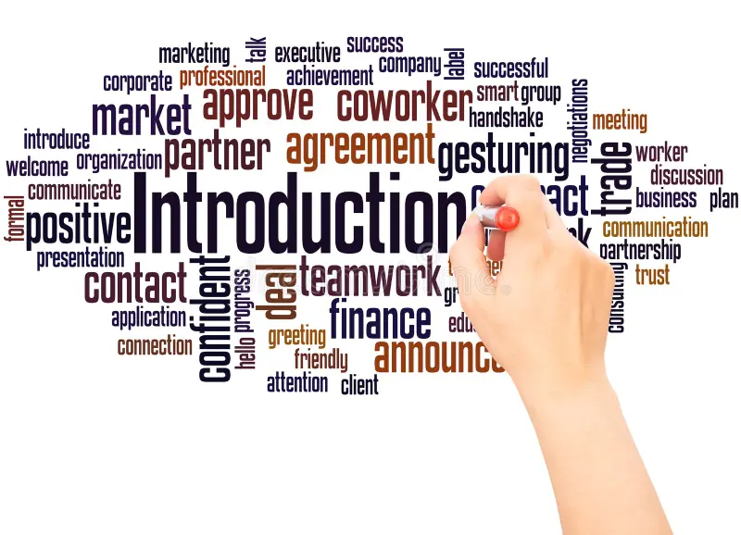
Introduction
Project Overview:
Developed a professional social media mobile application called BizzLink.
Aimed at entrepreneurs and business owners for enhanced collaboration and growth.
Core Purpose:
Facilitating meaningful connections within the professional community.
Providing a platform for networking, collaboration, and business enhancement.
Technological Foundation:
Utilized cutting-edge technologies: Flutter, Node.js, Express.js, MySQL, and Firebase.
Ensured a seamless, secure, and efficient experience for users.
Public Accounts Approach:
Opted for public profiles to maximize visibility and accessibility.
Creating a dynamic network of professionals across various industries.
User-Centric Design:
Prioritized a professional user interface and experience.
Tailored features to align with the latest trends in business and entrepreneurship.
Engagement and Collaboration Focus:
Emphasis on features like direct messaging, post interactions, and user exploration.
Enabling users to connect, collaborate, and foster business growth.

Slide 4



Literature Review
LinkedIn:
Drawback: While LinkedIn is a professional networking platform, it may not be specifically tailored for business service listings and collaborations.
Solution: Your app could provide a dedicated space for businesses to list their services and easily find potential collaborators within their industry. It could also facilitate seamless communication and project management.
Facebook Groups:
Drawback: While Facebook groups can foster discussions, they may lack dedicated features for business service listings and may not provide a professional environment for collaboration.
Solution: Your app could offer a more structured and business-oriented environment, with features for listing services, searching for potential partners, and facilitating collaboration. It could also include tools for project management and secure communication.
B2B Marketplaces (e.g., Alibaba):
Drawback: B2B marketplaces often focus on product sales and may not offer a space for detailed service listings or nuanced collaborations.
Solution: Your app could cater specifically to service-oriented businesses, allowing them to detail their offerings comprehensively. Additionally, it could provide features for finding complementary services and forming partnerships.

Slide 5
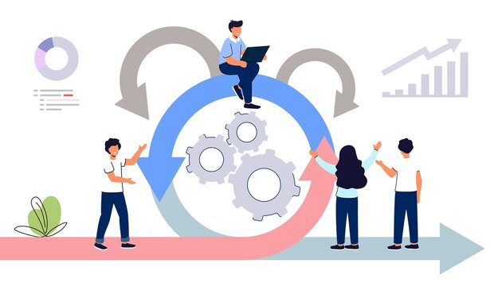
Proposed Systems
Vision and Goals:
Vision: BizzLink aims to be a premier networking platform for entrepreneurs, fostering collaboration and business growth.
Goals: Connect entrepreneurs globally, provide a platform for showcasing services, and enhance professional networking.
Target Audience and Needs:
Target Audience: Entrepreneurs and business owners.
Needs: Efficient networking, professional service showcasing, streamlined communication.
Justification for Technologies:
Flutter for a consistent cross-platform UI.
Node.js and Express.js for a scalable and fast backend.
MySQL for structured data storage.
Firebase for seamless image handling.
Contribution to Functionality:
Flutter ensures responsive UI.
Node.js enables real-time communication.
MySQL ensures data integrity.
Firebase facilitates quick image storage.

Slide 6
Proposed Systems
User-Centric Design:
User interviews, surveys, and personas guided design decisions.
Iterative design based on user feedback and usability testing.
Understanding User Needs:
Identified pain points: inefficient networking and communication.
Explored preferences for intuitive navigation and appealing design.
Key Features for Initial Release:
User Profiles: Highlighting professional backgrounds.
Direct Messaging: Real-time communication for collaboration.
Explore Page: Discover and connect with potential collaborators.
Justification for Feature Selection:
Profiles enhance credibility.
Direct messaging streamlines collaboration.
Explore page promotes networking.
Benefits of Public Profiles:
Facilitates easy discovery of services and businesses.
Encourages connections through transparent networking.

Slide 7
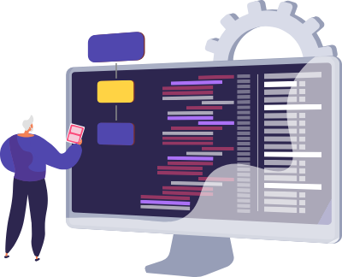
System and Software Requirements
System Requirements:
Operating System:
BizzLink is compatible with iOS and Android operating systems.
Users should have a minimum version of iOS 12 or Android 8.0 for optimal performance.
Device Specifications:
The application requires a smartphone with at least 2GB of RAM for smooth functioning.
Recommended screen resolution for an optimal user experience.
Internet Connectivity:
BizzLink relies on a stable internet connection for real-time updates and messaging.
A minimum bandwidth of 3G is recommended for seamless functionality.
Software Requirements:
Frontend Framework:
BizzLink utilizes Flutter, a cross-platform UI toolkit, for the frontend.
Users need to have the latest version of the BizzLink mobile application installed.
Backend Framework:
The backend is powered by Node.js and Express.js for robust server-side logic.
No additional software requirements for end-users.
Database:
MySQL is employed for data storage and retrieval.
No direct user interaction with the database is required.
Image Storage:
Firebase is used for efficient storage of images.
Users need not interact with Firebase directly; it's seamlessly integrated into the app.

Slide 8
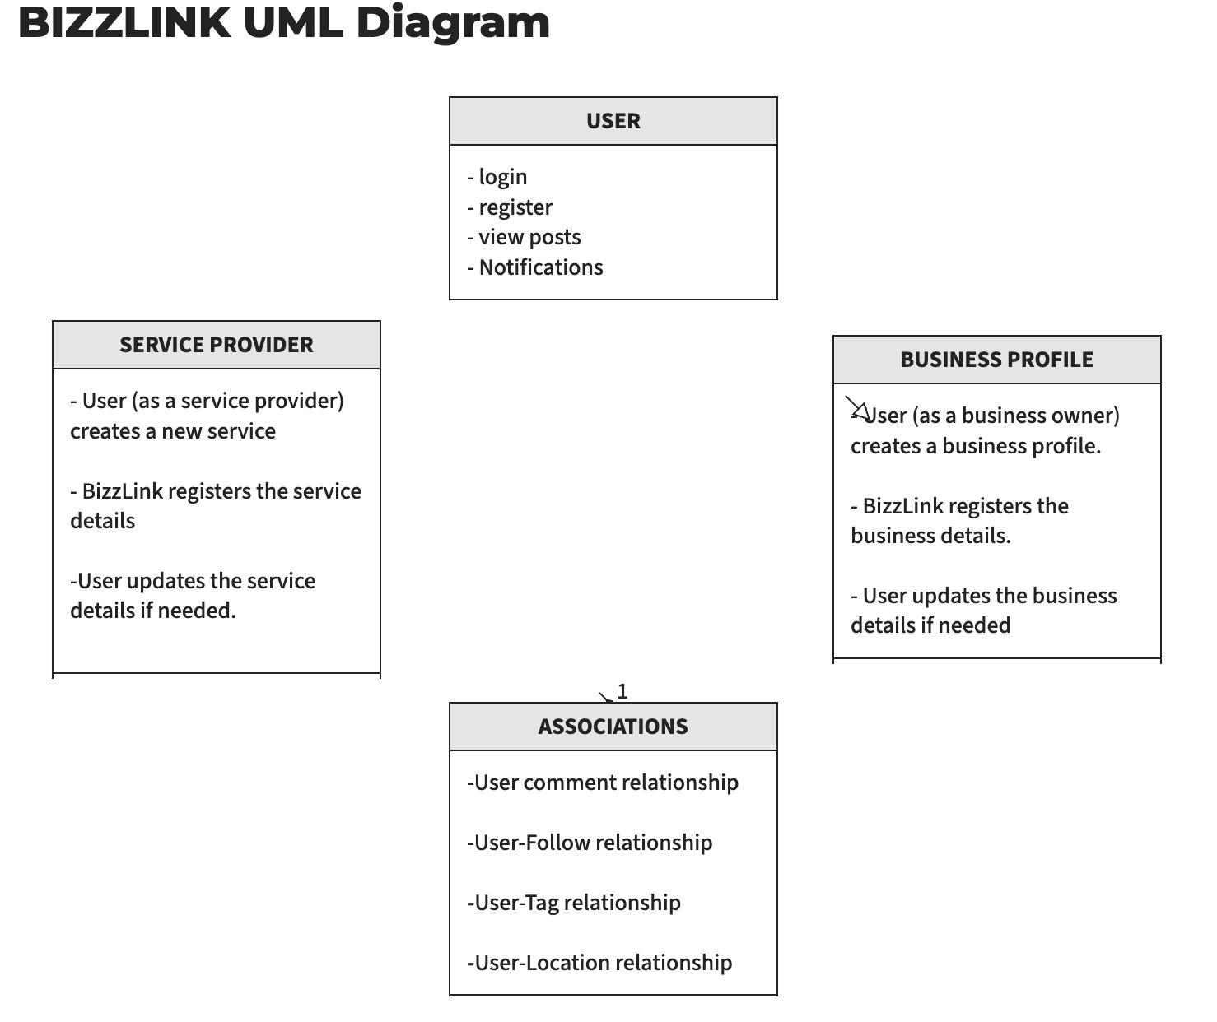
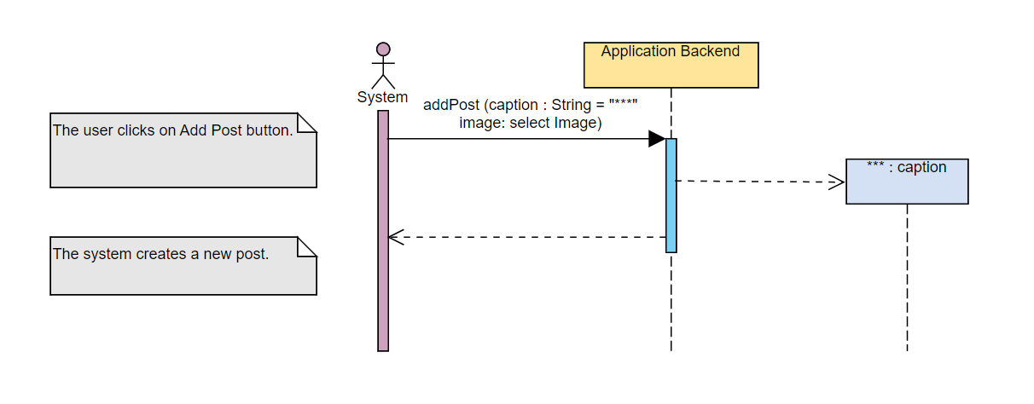
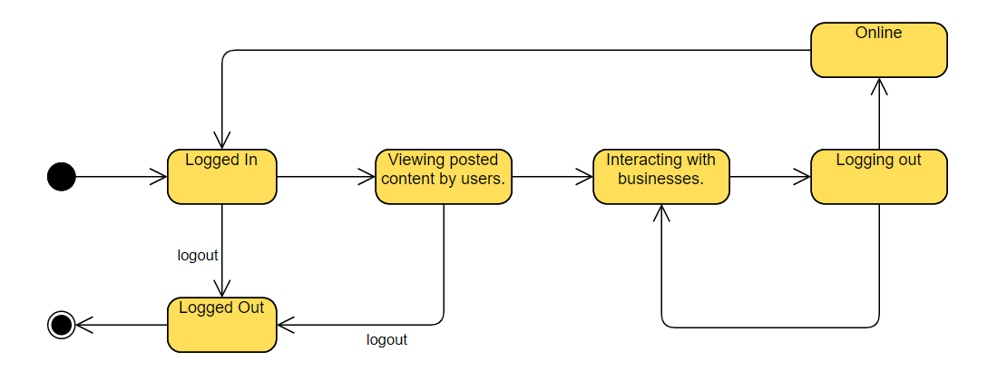
Unified Modelling Language (UML) Diagrams
Class Diagram
Create Post Activity Diagram
User Journey State Machine Diagram

Slide 9
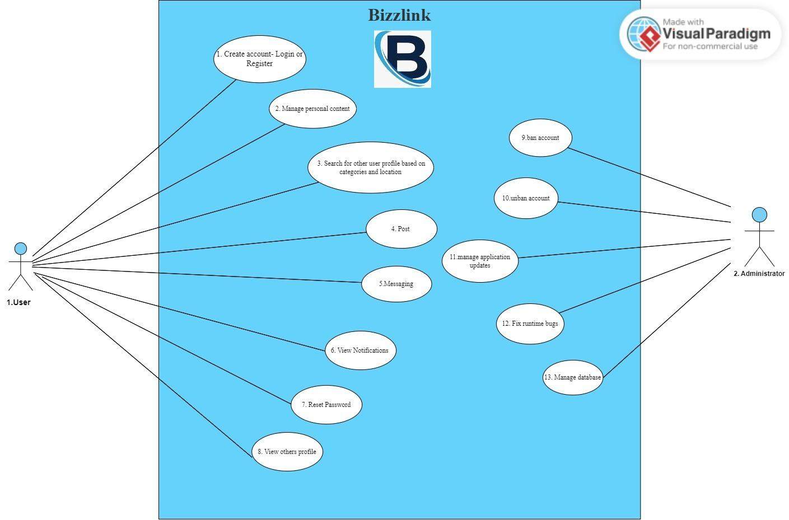
Use Case Diagram

Slide 10
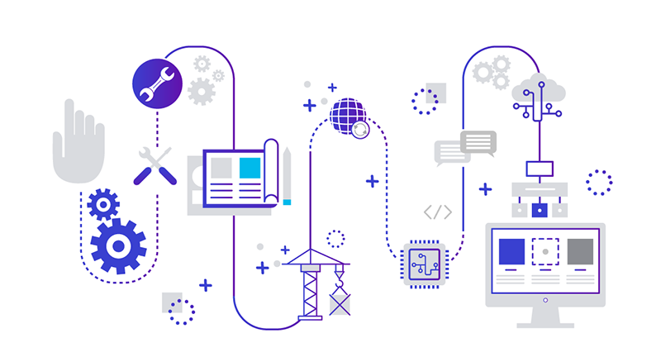
Overview of Algorithms used - Frontend
Register Page
1. Define a Flutter StatefulWidget named RegisterPage with various TextEditingController variables.
2. Implement a form with text input fields for user registration information.
3. Validate user inputs and display error messages if needed.
4. Create a Service class with a method (saveUser) to make an HTTP post request to register a user.
5. Handle the registration response, save the user ID if successful, and navigate to the home page.
6. Implement UI interactions, such as showing a loading button during registration.
Direct Message Page
1. Create a FollowerPage that displays a list of followers.
2. Use ListTile for each follower with profile information.
3. Navigate to the follower's profile page on tap.
4. Implement a BottomNavigationBar for navigation.
5. Handle navigation logic for Home, Search, Plus, and Notification.
6. Update the import statement for UserProfilePage.
Profile Page
1. Define the 'PostDisplayPage' class with necessary parameters for displaying a post.
2. Implement a stateful widget for 'PostDisplayPage' with functions to load user ID, fetch comments, toggle like, post comments, and delete comments.
3. Build the UI structure with an app bar, user information, post image, like and comment buttons, and a comments section.
4. Implement logic to handle like button clicks, navigate to the user profile on username tap, and navigate to the direct message page on the message button tap.
5. Display the post details, including the username, caption, image, like count, and comments.
6. Use a bottom navigation bar for navigating between different sections of the app (Home, Search, Plus, Notification).
Explore Page
1. Define a StatefulWidget named SearchPage.
2. Initialize necessary variables and lists for user data and selected category.
3. Implement initState() to load user ID and initial user data.
4. Create UI elements including a dropdown for category filtering, a search bar, and a GridView for displaying users.
5. Implement asynchronous functions to load user data based on selected category and to handle user ID loading.
6. Build the main Scaffold with an AppBar, a filter dropdown, a search bar, a horizontal list, and a GridView of user cards.
Home Page
1. HomePage widget displaying user posts.
2. Fetch posts from the server using HTTP requests.
3. Like button functionality with HTTP requests.
4. User profile and post details navigation.
5. BottomNavigationBar for navigation.
6. Actions for message, profile, and post details.

Slide 11
Overview of Algorithms used - Backend
Backend
1. Initialize Express application, configure middleware (body-parser, cors), and set up database connection.
2. Define routes for user-related operations (register, login, profile, update, followers, following, etc.).
3. Implement registration route (/user/register) to check for duplicate usernames, emails, and mobile numbers before inserting a new user into the database.
4. Create a login route (/user/login) to authenticate users based on mobile number and password.
5. Implement routes for user profile manipulation (/user/profile/:userId, /user/update/:userId).
6. Define routes for handling followers and following relationships (/user/followers/:userId, /user/following/:userId).
7. Implement routes to retrieve and display follower/following lists for a specific user or user profile.
8. Create routes for posting and loading posts (/user/post, /user/loadposts/:userId).
9. Implement a route to toggle like status on a post (/user/toggleLike/:postId).
10. Create routes to load and display user posts (/user/loaduserposts/:username, /user/loadcurrentuserposts/:userId).
11. Implement routes for checking if a user is following another (/user/checkfollowing/:currentUserId).
12. Define routes for following and unfollowing users (/user/followuser/:currentUserId, /user/unfollowuser/:currentUserId).
13. Implement routes for handling direct messages (/user/recentmessages/:userId, /user/loadmessages/:userId/:receiverId, /user/sendmessage).
14. Create routes for user search and displaying search results (/user/loadsearchpageusers/:userId).
15. Implement routes for checking email existence (/user/checkEmail/:email).
16. Define routes for loading notifications and handling notification-related operations (/user/loadnotifications/:userId).
17. Implement routes for loading and handling comments on posts (/user/loadcomments/:postId, /user/postcomment, /user/deletecomment/:commentId).
18. Export the defined routes for use in the main application file.
19. Run the Express application, listen on a specified port and IP address.

Slide 12
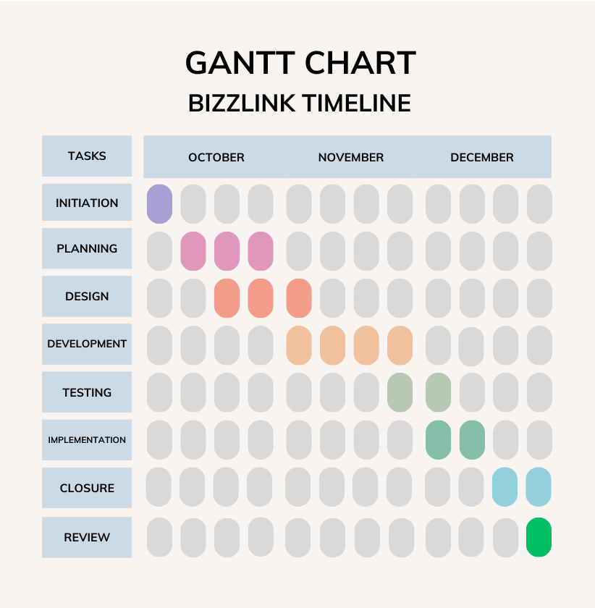
Project Timeline - Gantt Chart

Slide 13
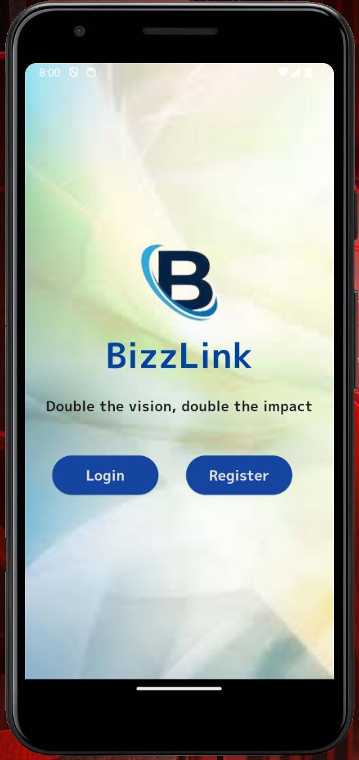
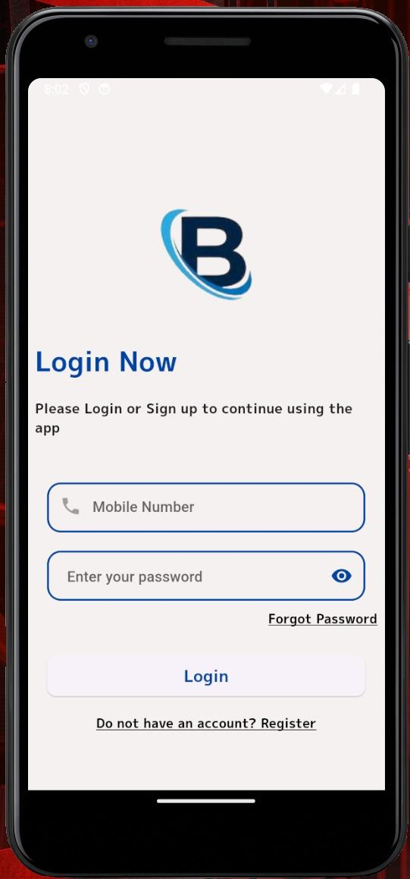
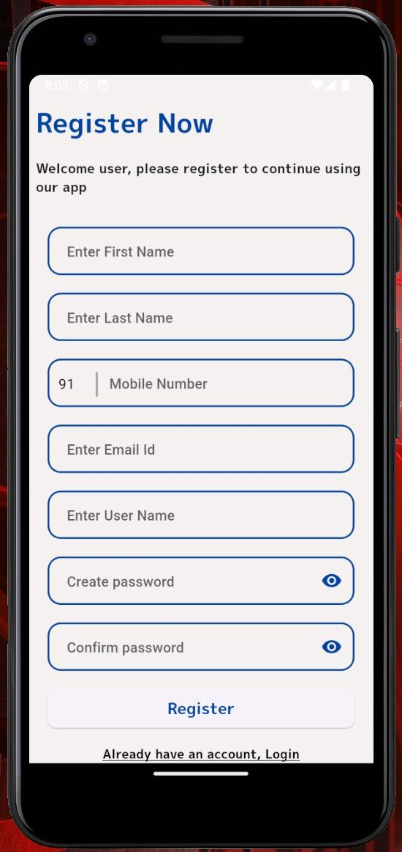
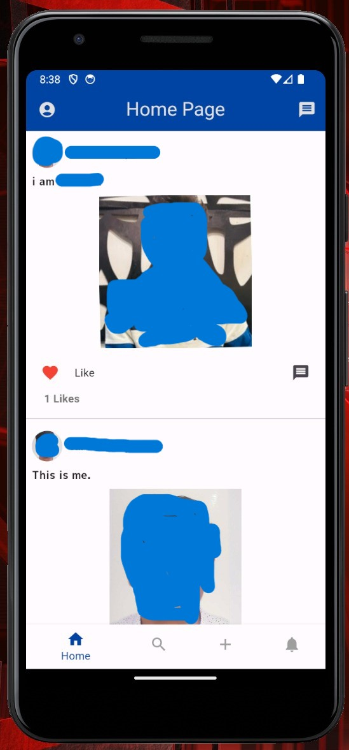
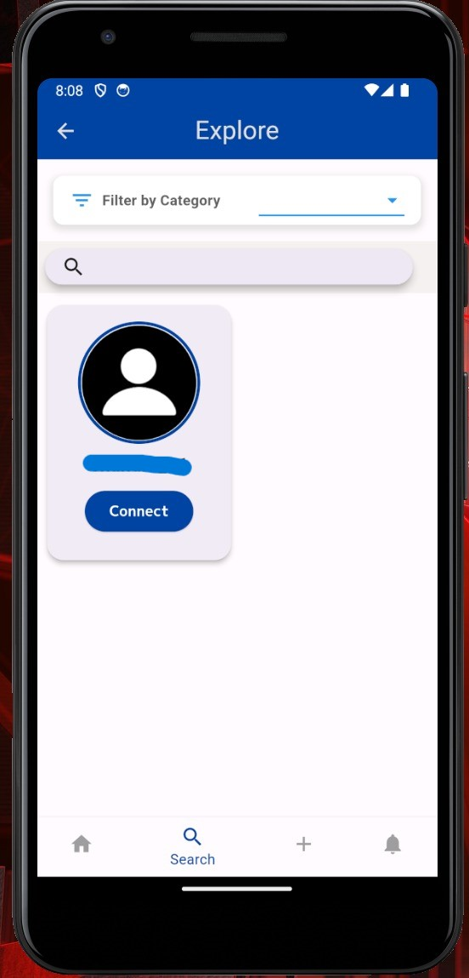
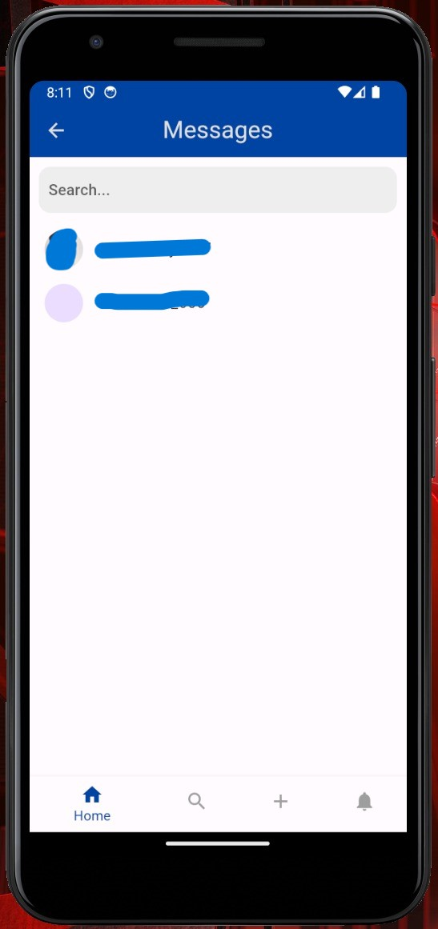
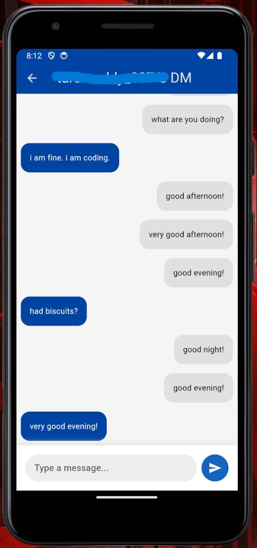
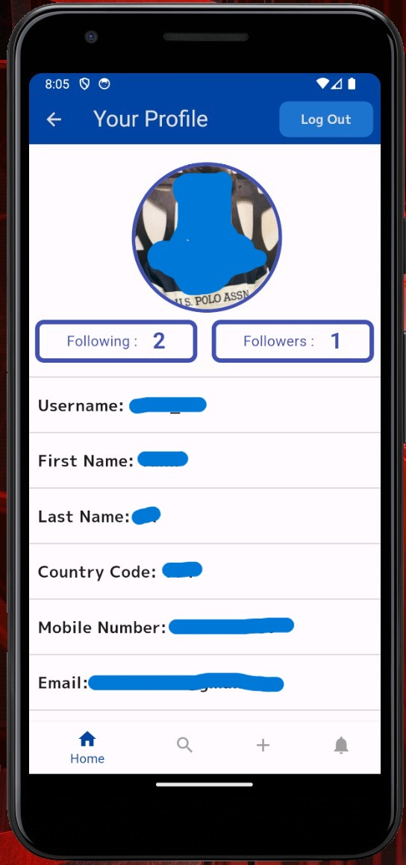
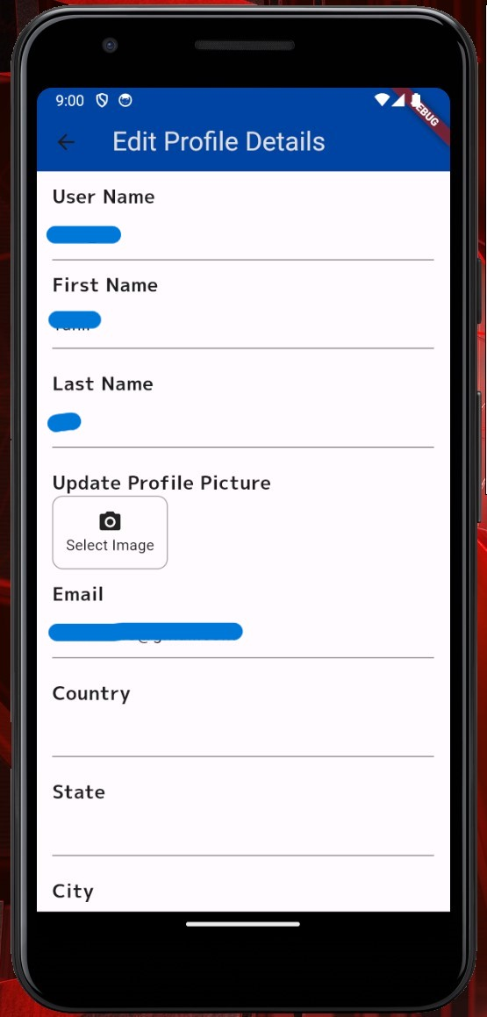
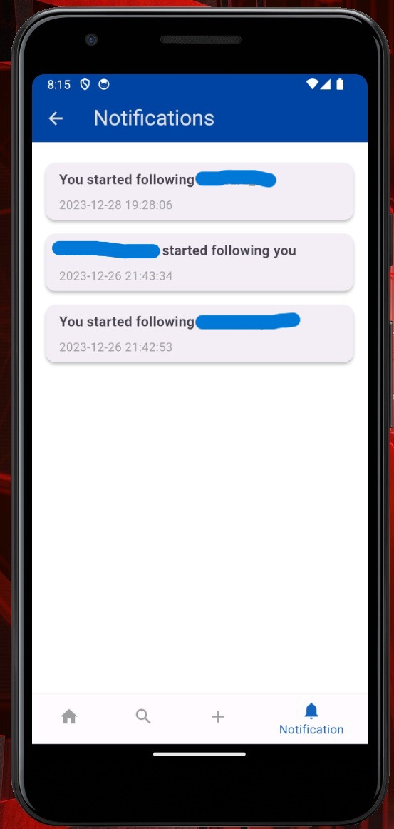
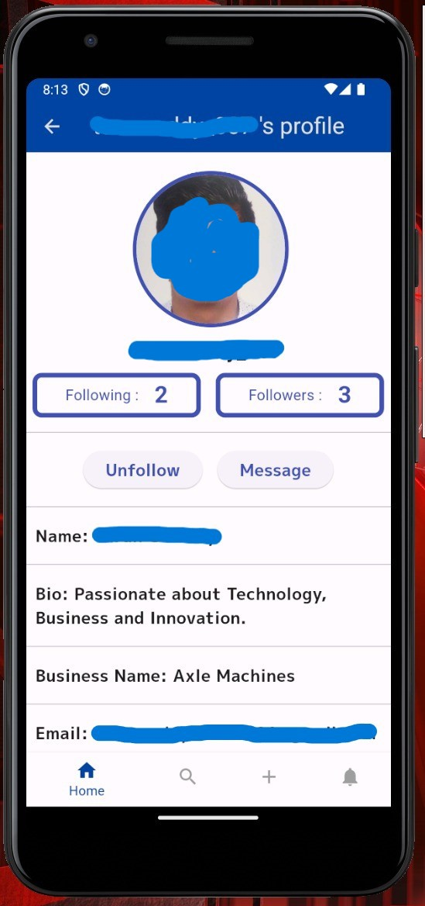
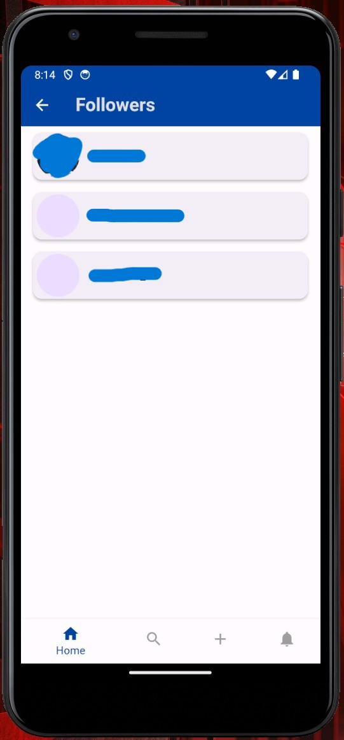
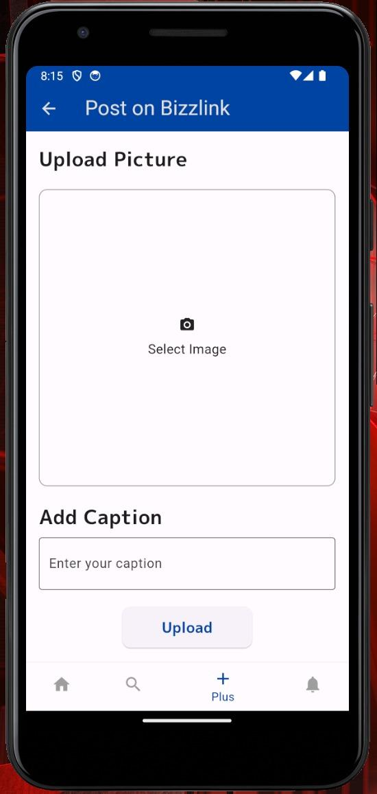
Result Snippets

Slide 14

Conclusion
Project Success:
The BizzLink project has achieved its goals of creating a dynamic, professional networking platform for entrepreneurs and business owners.
Impact on Professional Connectivity:
BizzLink has successfully contributed to fostering meaningful connections, collaborations, and partnerships within the professional community.
Innovation and Adaptability:
The project's use of cutting-edge technologies, responsive design, and adaptability to ongoing trends showcases a commitment to innovation.
User-Centric Design:
The user-centric design and continuous feedback loop have been instrumental in optimizing the overall user experience.
Future Expansion and Enhancements:
The project is designed with scalability in mind, leaving room for future expansion and enhancements to meet the evolving needs of users.
Strategic Business Tool:
BizzLink is positioned as a strategic tool for professionals, providing not just a networking platform but a catalyst for business growth.

Slide 15

Future Scopes
Global Expansion:
Explore the possibility of expanding the platform to cater to a global audience of entrepreneurs and businesses.
Advanced Filters:
Implement more advanced filters for users to narrow down search results based on specific criteria like industry, skills, etc.
Business Analytics:
Integrate analytics tools to provide users with insights into their posts' performance and audience engagement.
Collaboration Features:
Incorporate features that facilitate collaboration between businesses, such as joint ventures, partnerships, or shared projects.
Including more Features:
Have an updates tab at the top where users can post instant update which can viewed by others to know more about what’s happening.

Slide 16

References
Professional Social Media Platforms
Feller, J., & Fitzgerald, B. (2009). Online social networking sites: A look at the evolution of MySpace and the emergence of Facebook and LinkedIn. Computers in Human Behavior, 25(3), 449-458.
Mobile App Design and Functionality
Shneiderman, B. (2020). Designing the User Interface: Strategies for Effective Human-Computer Interaction (6th ed.). Taylor & Francis.
Future Trends in Business Networking and Collaboration
Schwab, K. (2017). The Fourth Industrial Revolution. Currency.
Additional References
Barabási, A.-L. (2016). Network Science. Cambridge University Press.

Slide 17


